Slide 1
WELCOME

Slide 2

MET
Presentation on :- Examination System Project Session :-
2017-2018
Submitted by:- supervision:-
Dr/Lobna abo elmaged
Hesham mahmoud elalawy
Mohamed ebrahim abo elhamed
Mohamed fread elkholy
Mahmoud samir abd elsamea

Slide 3
Examination System
Contents:-
Introduction
Problem definition
Problem Solution
Technology Used
Project Analysis And Design
Data Flow Diagram(DFD)
DataBase Diagram
ER Diagram (ERD)
Merits of project

Slide 4
Introduction
Examination system refers conduct to service as examination or test.
examination system will use in schools, colleges, universities.
Exam System is very useful for Educational Institute to prepare an exam, safe the time that will take to check the paper and prepare mark sheets. It will help the Institute to testing of students and develop their skills. But the disadvantages for this system, it takes a lot of times when you prepare the exam at the first time for usage.

Slide 5
Problem Definition
Students need to wait for their results.
Examiner are not able to maintain the student record in large quantity.
And another problem of sending question paper from one place to another place.
• And have the problem of leaking the paper before examination but this problem will not born in examination system.
• And have a problem of change the choice of option which is not possible in paper .

Slide 6
Problem Solution
We introduce our project to conduct exam easily by application and web and reducing paper work.
We provide user id and password. The id is unique so its data will be secured.
Admin can upload the Exam.
Admin can change the profile of student.

Slide 7
Technology used
Technology
PHP (language)
Mysql
Android

Slide 8
Front end technology:-
HTML
CSS
JavaScribt(Jquery Lib)
4.Bootstrab
.
Hardware requirement :- Basic computer system and mobile.

Slide 9
Back end technology:-
PHP:-
Mysql:-
Software Requirement:- (Any one(
WAMP Server
XAMP Server
Apache Server
PhpmyAdmin

Slide 10
Project Analysis And Design
This project will complete in two module which are as follow:-
EXAMINATION SYSTEM
ADMIN
STUDENT

Slide 11

Admin Aspects
Taking back up of the database.
Editing/deleting/creating the database.
Changing the password.
Logging into the system.
Posting question in the above test.
View a particular student and delete the student.
Show result of examination.

Slide 12

Student Aspects
Read the instruction of accessing this site.
Request for registration.
See the notification for Test.
Logging into the system.
Appear the Test or Exam.
Find result at the end of exam

Slide 13
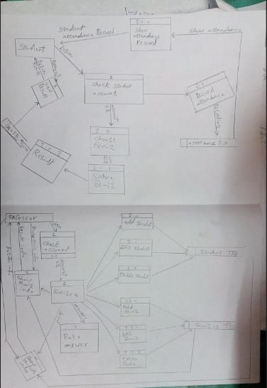
Data Flow Diagram(DFD):

Slide 14
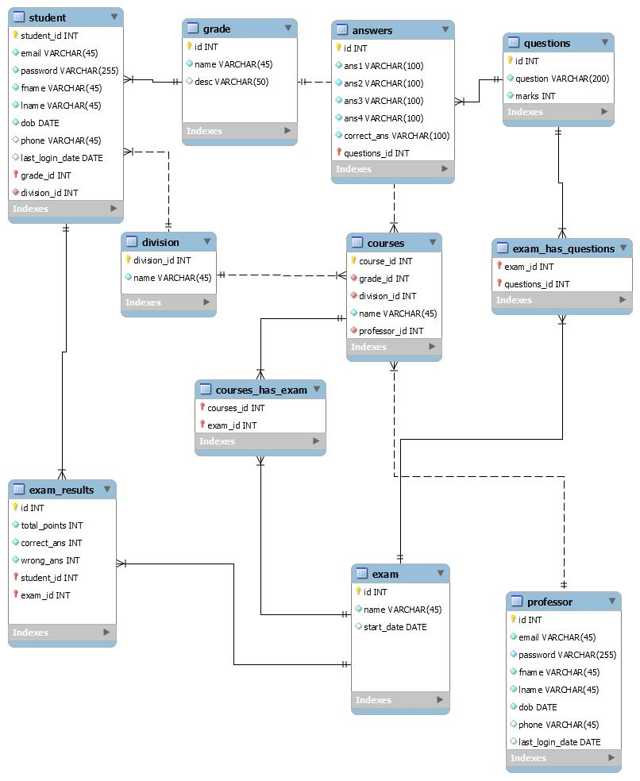
DataBase Diagram:

Slide 15
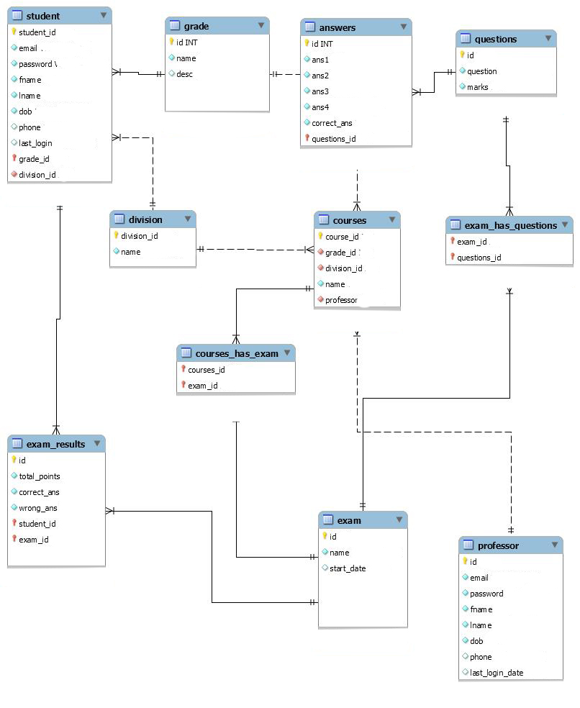
ER Diagram (ERD):

Slide 16
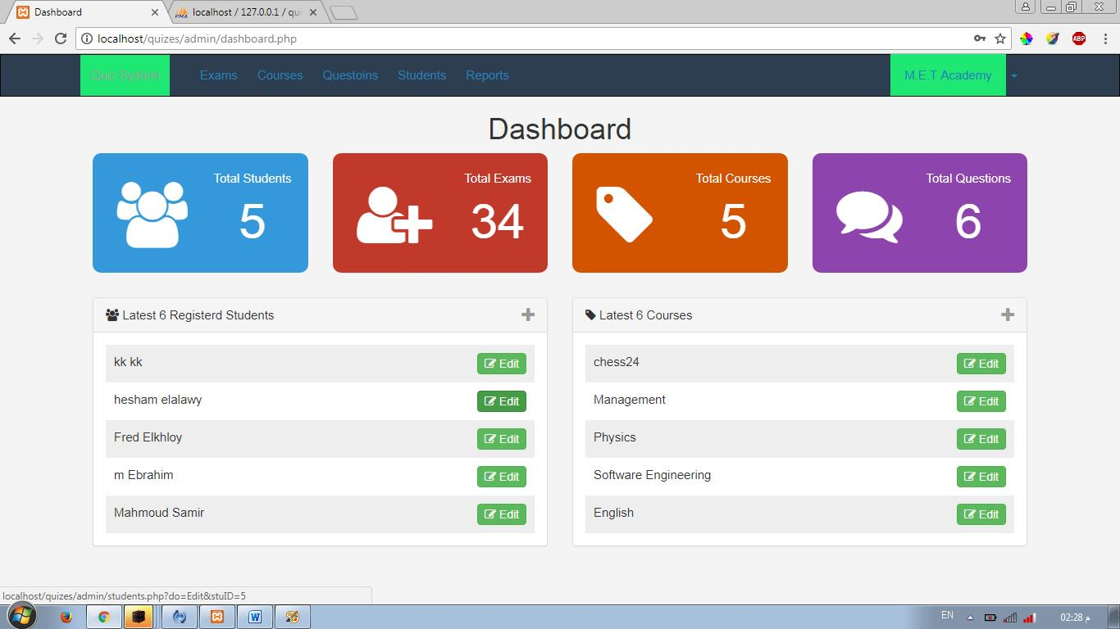
Home Page for Admin:-

Slide 17
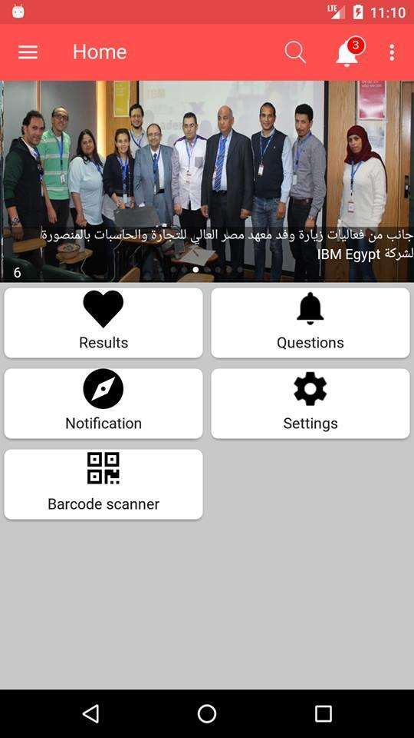
Home Page for student:-

Slide 18
Merits of examination project
General problem with time for students.
Auto grading.
Flexible.
Time saver.
Security.
The logs of appeared students and their marks are stored in database for future use.
Result will be very precise and accurate.

Slide 19
Result will automatically generated by the android Application.
Administrator has a privilege to create, modify and delete the test.
User can register, login and got the test with his/her specific Card ID and password.
Student can see the examination.
Avoid the paper work.
result immediately after

Slide 20
THANK YOU
Thanks to you all for give opportunity to represent our project presentation in front of you all.

